Slide 1
amazon

Slide 2
01
Tasks
02
Benefits
03
Statistics
04
Yearly Growth Chart
Contents
05
Monthly Growth Chart
06
Revenue
07
Revenue by Products
08
Sales and Profit
09
Conclusion

Slide 3
Tasks
To analyze the Sales-trend -> month-wise, year-wise, yearly_month-wise
Find key metrics and factors and show the meaningful relationships between attributes.

Slide 4
Benefits
Help out to make better business decisions.
Help analyze customer trends and satisfaction, which can lead to new and better products and services.
Gives better insight of customers base.
Helps in easy flow for managing resources

Slide 5
Statistics
A quick insight for 2010 | 2011 | 2012 | 2013 | 2014 | 2015 | 2016 | 2017 amazon sales
10+
70+
PRODUCTS
COUNTRIES
Product categories represents a diverse range of consumer interests and preferences, making amazon’s sales data a valuable resource for business growth.
The sales data across these countries provides invaluable insights into customer behaviour, market trends, and economic dynamic.
137m+
44m+
TOTAL SALES
TOTAL PROFIT
This monumental figure encapsulates transactions across diverse product categories, highlighting amazon’s pervasive influence on consumer spending habits worldwide.
Profit reflects the company’s operational efficiency, strategic investments, and relentless focus on innovation

Slide 6
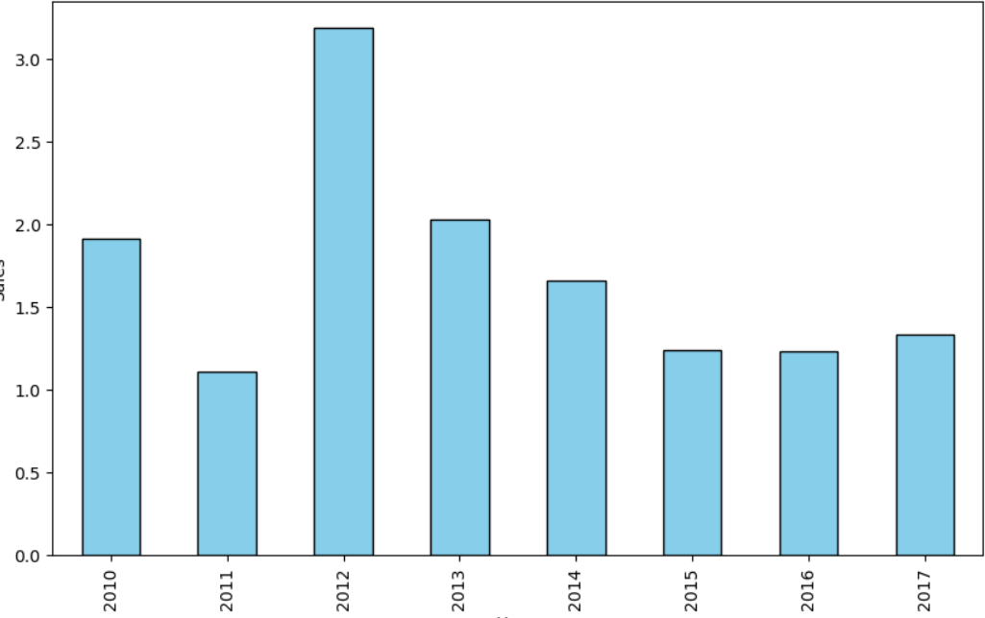
Yearly Growth Chart
2012 has the highest revenue

Slide 7
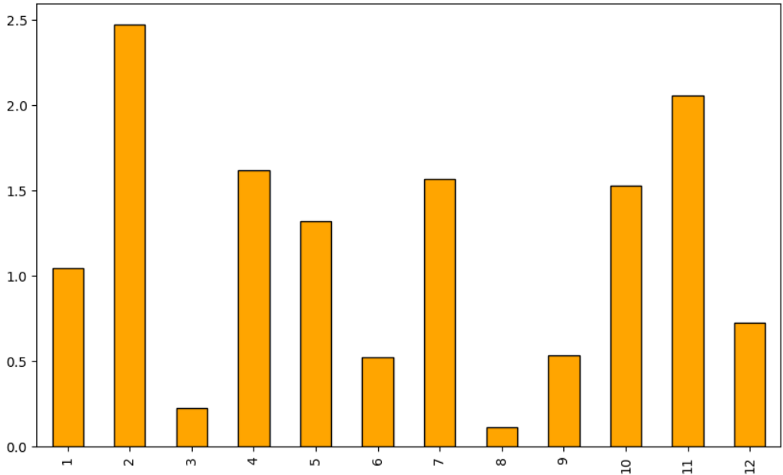
Monthly Growth Chart
February has the highest sales

Slide 8
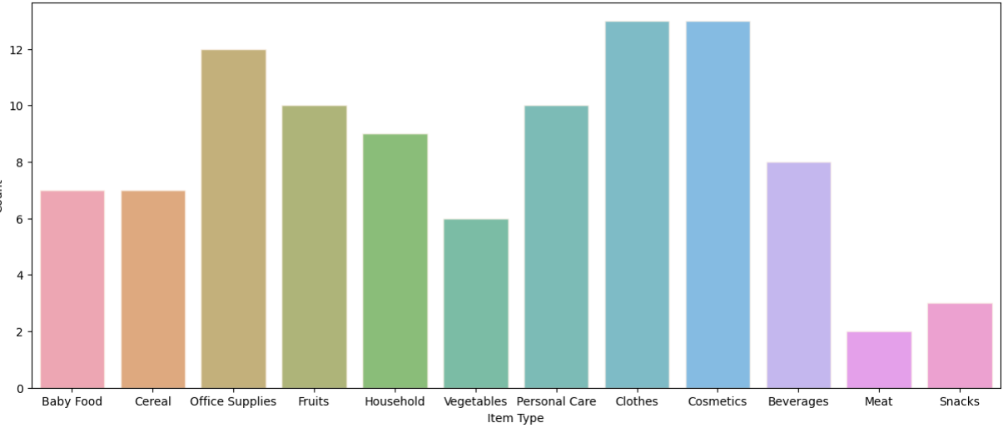
Revenue by Products
Cosmetics emerge as the product category with the highest sales. This finding underscores the significant demand for cosmetic products among Amazon's customer base. The popularity of cosmetics highlights the importance of beauty and personal care products in e-commerce,

Slide 9
Revenue
63 Million
revenue in Honduras
This impressive figure highlights the country's growing influence in the global e-commerce market. Leveraging its strategic advantages and thriving business environment, Honduras has demonstrated its potential to drive substantial economic activity on digital platforms.

Slide 10
Sales &Profit by region
Sub Saharan has the highest profit and sales
Sub Saharan Africa
Europe
Asia
Middle East & North America
Australia & Oceania
Central America & Caribbean
North America

Slide 11
Conclusion
If we observe the monthly insights of the sales are at their peak in February, May and October and are low in September, March & August. Amazon can come up with some good discounts and offers to generate high revenue.
The sales for the Honduras are highest among all countries and lowest in Brunei.
The Cosmetics & Office appliances are the highest selling products in domestic and international markets.
2012 had the highest Revenue at 31M

Slide 12
Thanks!

